Slide 1


Introduction to Data Science
Course: Introduction to Data Science
Lecturers: Dr. Naama Kopelman , Dr. Jonathan Schler.
Names: Oz Wiess, Vlad Sadovnikov
ID: 205650047, 321744096

Slide 2



Intro to research
Research question
1. Can we predict how many views, likes or comments YouTube videos can get?
2. Which video categories make them more popular?

Slide 3


Data Sources
Data Cleaning
Data set from Kaggle
Find how much ‘nun’ we have,
check all the data set have the same formats
Trending YouTube Video Statistics
Outliers handling

Slide 4



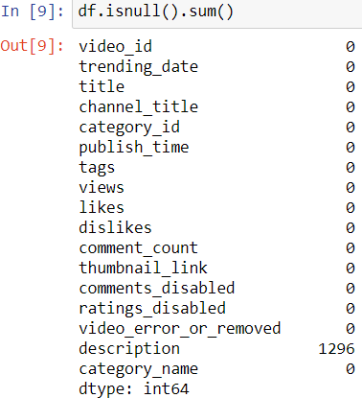
Missing Data

Slide 5

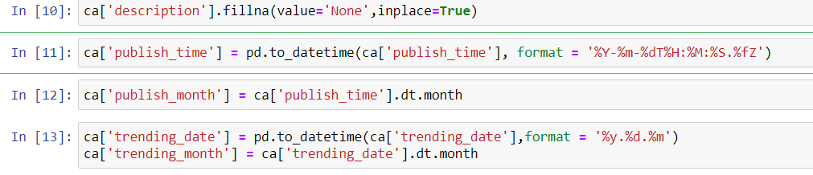
Formats of Date and Time

Slide 6

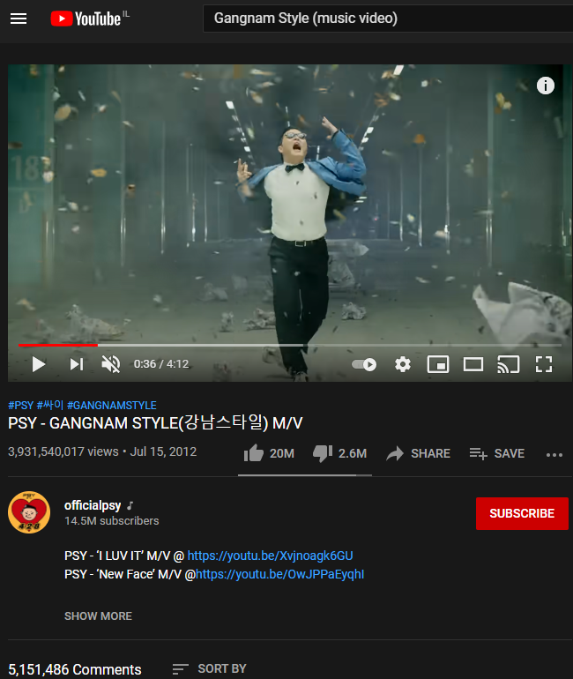


EDA
Gangnam Style:
First video over 1B views
Baby Shark:
Most viewed video today on YouTube.

Slide 7

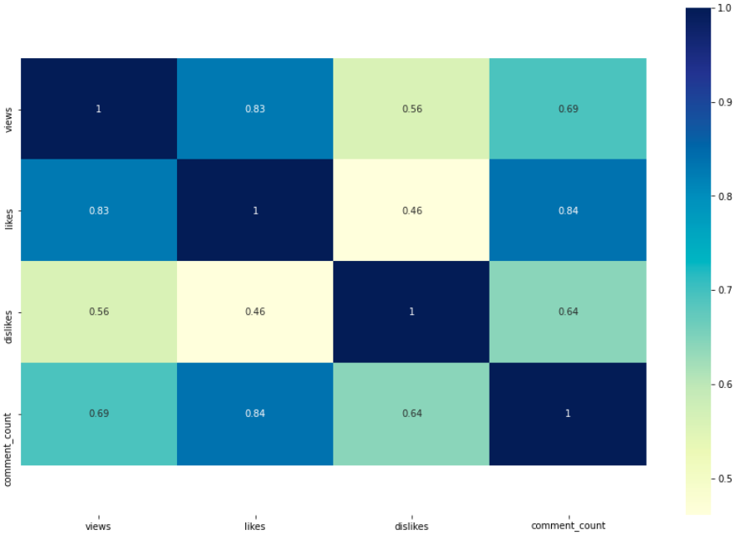
Most Correlated Parameters
Hight correlation:
+0.8
(likes: views)
(likes: comment count)
Medium correlation:
+0.6 (views: comment count)

Slide 8
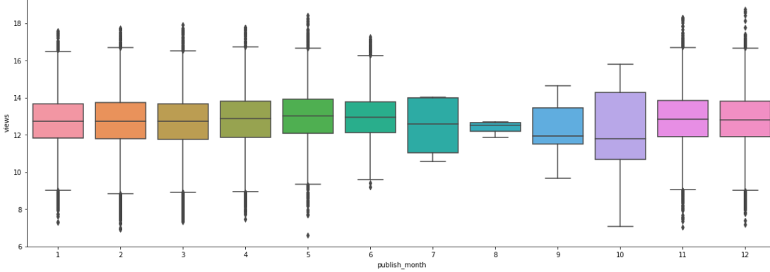
Marketing Funnel
Name: Boxplot which represents the amount of views video in relation to the month published.
X-axis: publish month
Y-axis: views
Conclusion: there are more views on videos that published on August and October.

Slide 9
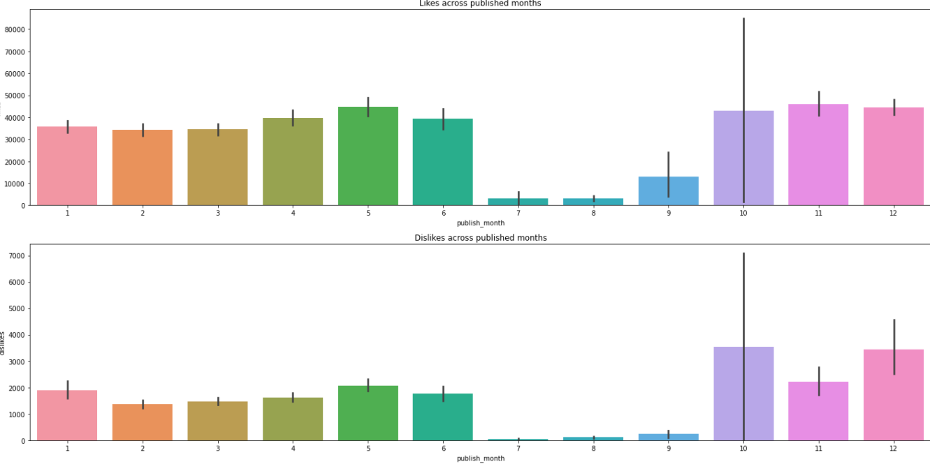
Amount of Likes/Dislikes by Month
Name: Barplot which represents the amount of likes/dislikes video in relation to the month published..
X-axis: publish month
Y-axis: likes/dislikes
Conclusion: easy to see that July, August and September have less activity.

Slide 10
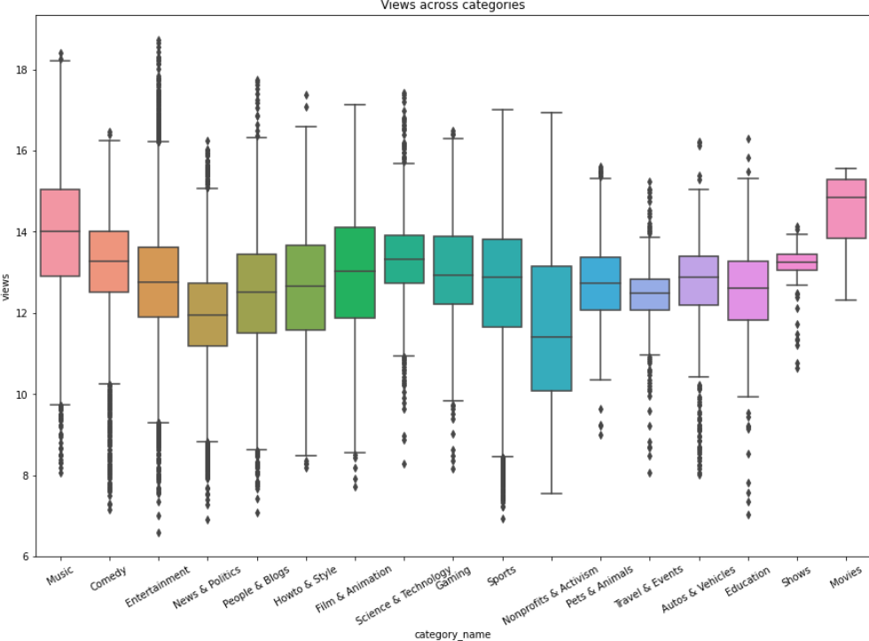
Amount of Views per Category
Name: Boxplot which represents the amount of views video in relation to video categories.
X-axis: category
Y-axis: views
Conclusion: music and movies are most viewed videos on YouTube.

Slide 11


Positive & Negatives
Some of the positives of YouTube are:
Educational Value
Ability to display user-created content
Some of the Negatives are:
Violence
Drugs

Slide 12
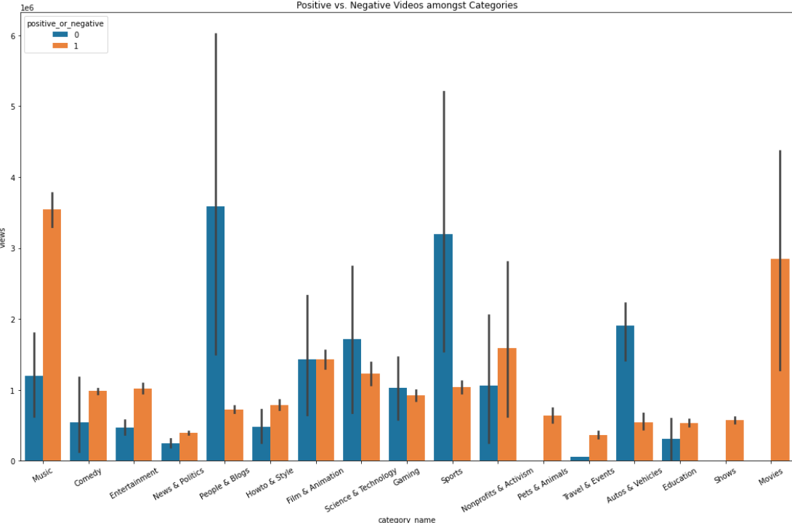
Positive or Negative?
Name: Boxplot which represents the amount of positive and negative videos in relation to video categories
X-axis: category
Y-axis: views
Conclusion: music and movie are the most popular videos although the have a lot of negative issues.

Slide 13
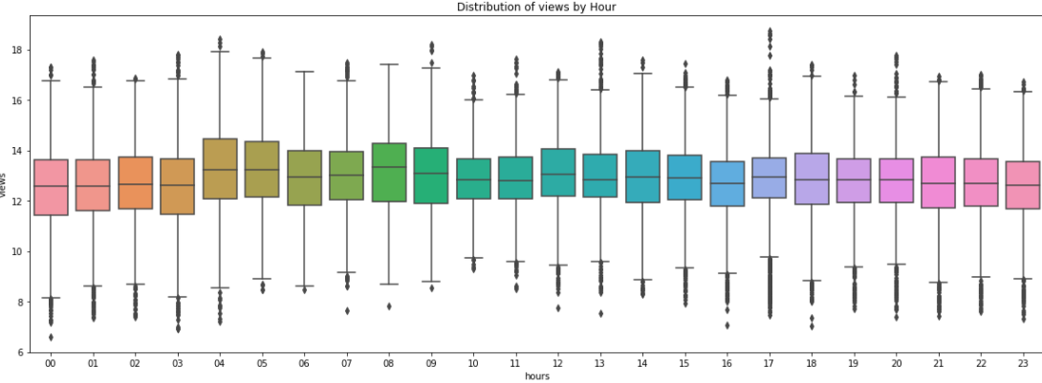
Time Against Popularity of Video
Name: Boxplot which represents the amount of views in relation to the hour that the video published.
X-axis: publish hour
Y-axis: views
Conclusion: not matter the hour of publishing the video.

Slide 14

Machine Learning
Of
Views

Slide 15


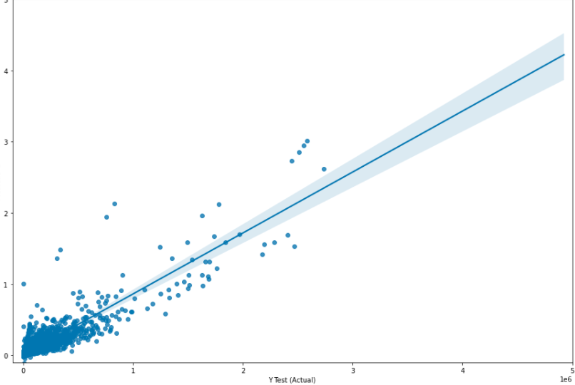
Linear regression
Using ‘sklearn’ library and linear regression we were able to train a model that predicts the popularity/success of newly uploaded videos on YouTube.
The model predicted that if we will be based on likes, views, and comments our r^2 will be 0.839.

